Slide 1

HyperText Markup Language (HTML)

Slide 2
Introduction
Standardized by World Wide Web Consortium (W3C)
Used to encode WWW documents (web pages)
Document-layout and hyperlink specification language
Defines the syntax and placement of various media like text, images etc. to be displayed by the browser
Marking up means addition of certain commands (in the form of tags) to our document in order to tell the browser how we want the document displayed

Slide 3
History of HTML and W3C
1961 - HTML
1994 – HTML 2.0
1996 – HTML 3.2
1997 – HTML 4.0
1999 – HTML 4.01
Today – XHTML
See http://www.w3c.org/

Slide 4
HTML and its Flavors
HTML – Hyper Text Markup Language
SGML – Standard Generalized Markup Language
XHTML - Extensible HyperText Markup Language
DHTML - Dynamic Hypertext Markup Language
XML – Extensible Markup Language

Slide 5
HTML Basics (Hierarchical Model)
HTML is structured in hierarchical order
Organized in hierarchical fashion such as File management in computer
DOM – Document Object Model

Slide 6
HTML Basics (Structure)
Basic structure
  <html>
  <head>
  <title>
  …
  </title>
  …
  </head>
  <body>
  …
  </body>
  </html>

Slide 7
Elements, Attributes and Tags
Tags – Commands to do something
Elements – Set of tags with content in between
Attributes – Modify the tags appearance and behavior

Slide 8
HTML Basics (Tag Guidelines)
All tags are contained within < and >.
No spaces between the <, >, and the tag text. Example: <html>
No spaces within tag text.
Tag types
  Container—to be closed
    example—html, body, title, font
  Standalone—no closing tag
    Example—br, hr, img,
Use the same case for all tag text, preferably lowercase text.
Keep horizontal symmetry.

Slide 9
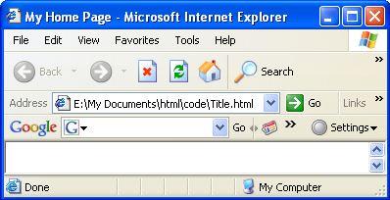
HTML tags
HTML comments
  <!--comment text-->…
Inserting a title
  Only one title element is permitted
  …
  <title>My Home Page</title>
  …

Slide 10
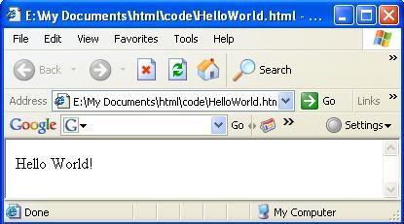
First HTML page
  <html>
  <head>
  <title>My First html page</title>
  </head>
  <body>
  Hello World!
  </body>
  </html>

Slide 11
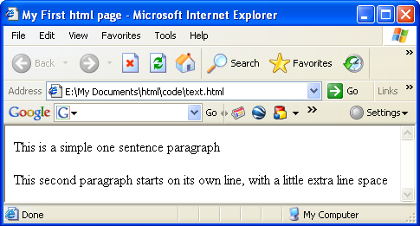
Working with text
Inserting a paragraph
  …
  <p>This is a simple one sentence paragraph</p>
  <p>This second paragraph starts on its own line, with a little extra line space</p>
  …

Slide 12
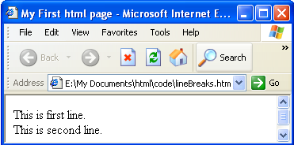
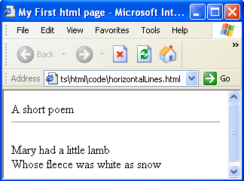
Working with text
Inserting line breaks
  Browser attempts to display all text in a single continuous line
  …
  This is first line.<br>
  This is second line.
  …
Inserting Horizontal line
  …
  A short poem
  <hr>
  <p>Mary had a little lamb<br>
  Whose fleece was white as snow
  …

Slide 13
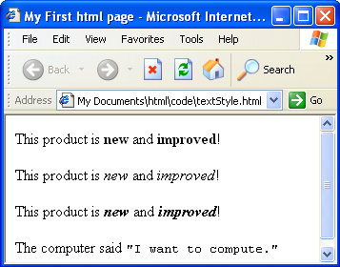
Changing text styles
  b—boldface, i—italics, tt—teletype etc.
  …
  <p>This product is <b>new</b> and <b>improved</b>!</p>
  <p>This product is <i>new</i> and <i>improved</i>!</p>
  <p>This product is <b><i>new</i></b> and <i><b>improved</b></i>!</p>
  <p>The computer said <tt>"I want to compute."</tt></p>
  …
  Elements can be nested

Slide 14
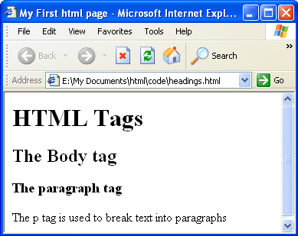
Headings
h1- through h6; numbers signify relative importance
  …
  <h1>HTML Tags</h1>
  <h2>The Body tag</h2>
  <h3>The paragraph tag</h3>
  The p tag is used to break text into paragraphs
  …

Slide 15
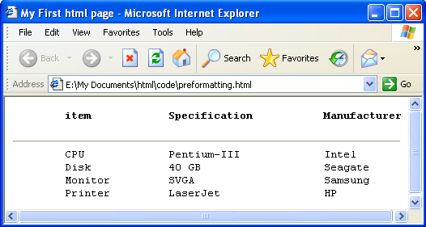
Pre-formatting text
Preserves white space entered into the source code
Uses monospace font
  <pre>
  <b> item Specification Manufacturer</b>
  <hr>
  CPU Pentium-III Intel
  Disk 40 GB Seagate
  Monitor SVGA Samsung
  Printer LaserJet HP
  </pre>

Slide 16
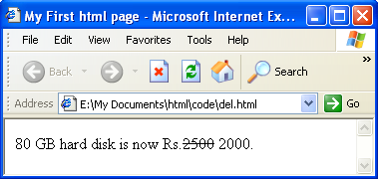
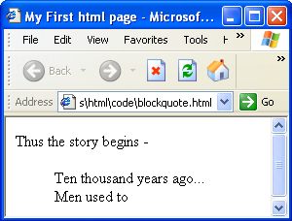
More text formatting
Strikethrough text
  80 GB hard disk is now Rs.<del>2500</del> 2000.
Indenting text
  Thus the story begins -
  <blockquote>
  Ten thousand years ago...<br>
  Men used to
  </blockquote>

Slide 17
HTML symbols
Result | Description | Entity Name | Entity Number
∀ | for all | &forall; | &#8704;
∃ | exist | &exist; | &#8707;
∅ | empty | &empty; | &#8709;
∈ | isin | &isin; | &#8712;
∋ | ni | &ni; | &#8715;
∏ | prod | &prod; | &#8719;
∑ | sum | &sum; | &#8721;
≤ | Less of equal | &le; | &#8804;
≥ | Greater or equal | &ge; | &#8805;
√ | square root | &radic; | &#8730;

Slide 18
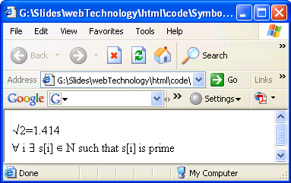
HTML symbol example
  &radic;2=1.414
  <br>
  &forall; i &exist; s[i] &isin; N such that s[i] is prime

Slide 19
HTML Colors
Color Name | Color HEX | Color
AliceBlue | #F0F8FF
AntiqueWhite | #FAEBD7
Aqua | #00FFFF
Aquamarine | #7FFFD4
Azure | #F0FFFF
Beige | #F5F5DC
Bisque | #FFE4C4
Black | #000000
BlanchedAlmond | #FFEBCD
Blue | #0000FF
BlueViolet | #8A2BE2
Brown | #A52A2A

Slide 20
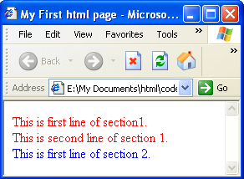
Creating divisions
Used to create sections
  …
  <div style="color:red">
  This is first line of section1.<br>
  This is second line of section 1.
  </div>
  <div style="color:blue">
  This is first line of section 2.<br>
  </div>
  …

Slide 21
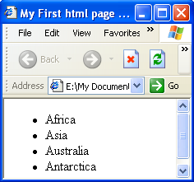
Unordered list
  …
  <ul>
  <li>Africa</li>
  <li>Asia</li>
  <li>Australia</li>
  <li>Antarctica</li>
  </ul>
  …

Slide 22
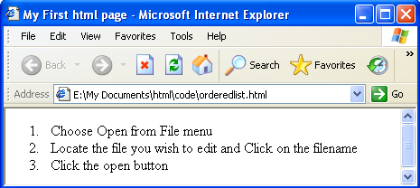
Ordered list
  …
  <ol>
  <li>Choose Open from File menu</li>
  <li>Locate the file you wish to edit and Click on the filename</li>
  <li>Click the open button</li>
  </ol>
  …

Slide 23
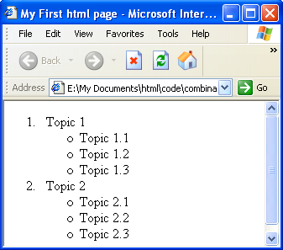
Combination list
  …
  <ol>
  <li>
  Topic 1
  <ul>
  <li>Topic 1.1</li>
  <li>Topic 1.2</li>
  <li>Topic 1.3</li>
  </ul>
  </li>
  <li>
  Topic 2
  <ul>
  <li>Topic 2.1</li>
  <li>Topic 2.2</li>
  <li>Topic 2.3</li>
  </ul>
  </li>
  </ol>
  …

Slide 24
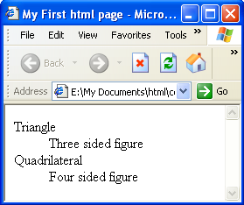
Definition list
  …
  <dl>
  <dt>Triangle<dd>Three sided figure
  <dt>Quadrilateral<dd>Four sided figure
  </dl>
  …

Slide 25
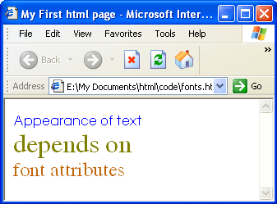
Displaying different Fonts
  …
  <font face="Century Gothic" color="blue">Appearance of text</font><br>
  <font face="Times Roman" color="olive" size="6">depends on</font><br>
  <font face="Times Roman" color="#C0660C" size="5">font attributes</font>
  …

Slide 26
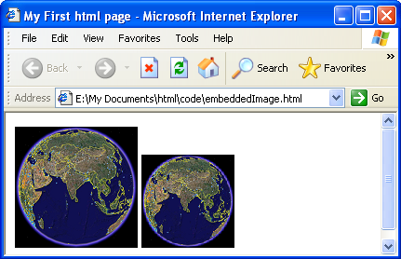
Working with images
Embedding images
  …
  <img src="earth.bmp">
  <img src="earth.bmp" width=100 height=100>
  …

Slide 27
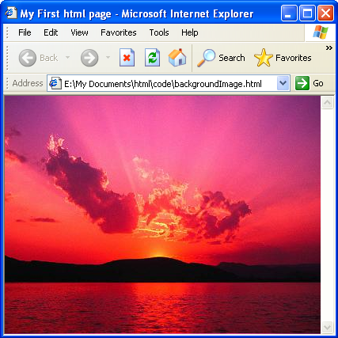
Background image
  …
  <body background=Sunset.jpg>
  </body>
  …

Slide 28
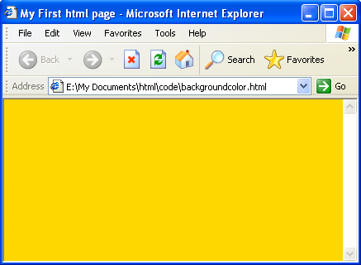
Background Color
  …
  <body bgcolor="gold">
  </body>
  …

Slide 29
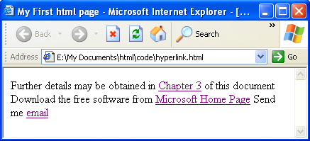
Working with Hyperlinks
Creating Hypertext
  …
  Further details may be obtained in <a href="charter3.html">Chapter 3</a> of this document<br>
  Download the free software from <a href="http://www.microsoft.com">Microsoft Home Page</a>
  Send me <a href="mailto:u_roy@it.jusl.ac.in">email</a>
  …

Slide 30
Creating bookmarks
  …
  <a href="bookmark.html#section3">go</a>
  <a name="section3">Section3</a>
  …

Slide 31
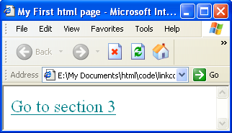
Changing link appearance
  …
  <a href="bookmark.html">
  <font size=5 color="#008088">
  Go to section 3
  </font>
  </a>
  …

Slide 32
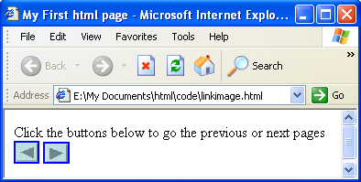
Hyperlinks
Hyperlinks with images
  …
  Click the buttons below to go the previous or next pages<br>
  <a href="chapter2.html"><img src="backward.jpg"></a>
  <a href="chapter4.html"><img src="forward.jpg"></a>
  …
Specifying link colors
  …
  <body link="green" vlink="gray">
  …

Slide 33
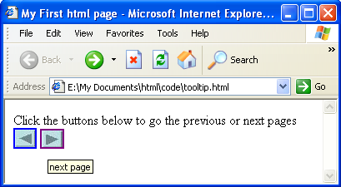
Creating tool tip label
Describes textual description for image
Specifies something about the target document
  Click the buttons below to go the previous or next pages<br>
  <a href="chapter2.html"><img src="backward.jpg" alt="previous page"></a>
  <a href="chapter4.html"><img src="forward.jpg" alt="next page"></a>

Slide 34
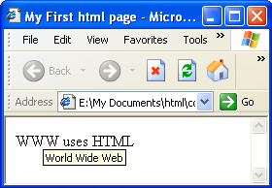
Creating Acronym
  …
  <acronym title="World Wide Web">WWW</acronym>
  uses <acronym title="HyperText Markup Language">HTML</acronym>
  …

Slide 35
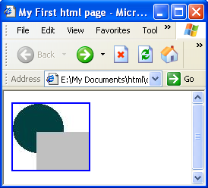
Image map
A graphic that can be divided into multiple areas
Each area can point to a different URL
Browser loads the URL on clicking the associated area
  <img src="shapes.jpg" usemap="#mainmap">
  <map name="mainmap">
  <area shape=circle coords="32,32,33" href="circle.html">
  <area shape=rect coords="31,37,100,90" href="rect.html">

Slide 36
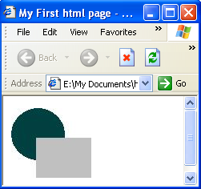
Working with head section
Base tag
  Used to specify base URL for all links in this page
  <head>
  …
  <base href="e:\My Documents\html\Picture\">
  </head>
  <body>
  <img src="shapes.jpg">
  </body>
  …

Slide 37
Meta tag
Keywords for search engines
  …
  <head>
  <title>My First html page</title>
  <meta name="keywords" content="html, JavaScript, Xml">
  </body>
  …
Redirecting to another page
  …
  <head>
  <meta HTTP-EQUIV="REFRESH" content="0; url=http://www.yahoo.com">
  </head>
  …

Slide 38
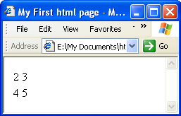
Advanced tags
Creating Tables
  table tag
    tr tag— table row
    td tag—table column
…
  <table>
  <tr> <td>2</td> <td>3</td> </tr>
  <tr> <td>4</td> <td>5</td> </tr>
  </table>
  …

Slide 39
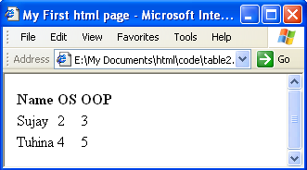
Creating Tables (contd.)
Adding column header
  th tag
…
  <table>
  <tr> <th>Name</th> <th>OS</th> <th>OOP</th> </tr>
  <tr> <td>Sujay</td> <td>2</td> <td>3</td> </tr>
  <tr> <td>Tuhina</td> <td>4</td> <td>5</td> </tr>
  </table>
  …

Slide 40
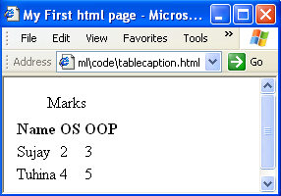
Creating Tables (contd.)
Adding a caption
  caption tag
…
  <table>
  <caption>Marks</caption>
  …
  </table>
  …

Slide 41
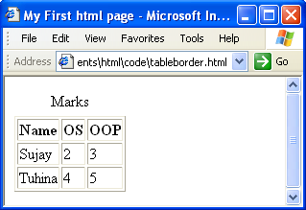
Creating Tables (contd.)
Adding border
  border attribute—default width is 1 pixel
…
  <table border>
  …
  </table>
  …

Slide 42
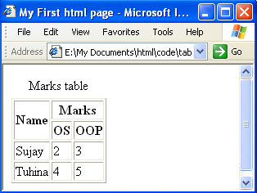
Creating Tables (contd.)
Adding column header
  rowspan number of rows caption spans
  Colspan number of columns caption spans
…
  <table border>
  <caption>Marks table</caption>
  <tr><th rowspan=2>Name</th><th colspan=2>Marks</th></tr>
  …
  </table>
  …

Slide 43
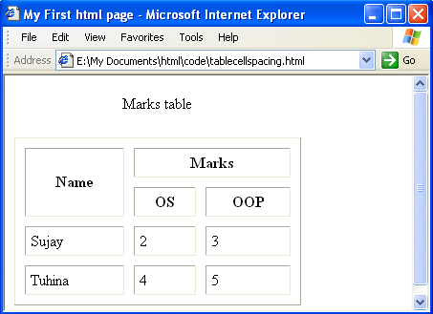
Creating Tables (contd.)
Cell spacing and cell padding
  cellspacing—spacing between cells
  cellpadding—gap between edge and the content of cell
…
  <table border cellspacing=10 cellpadding=5 width=300>
  …
  </table>
  …

Slide 44
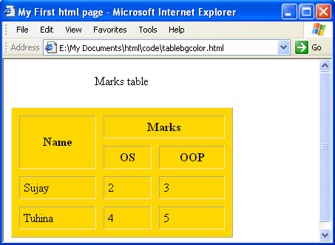
Creating Tables (contd.)
Background color
  bgcolor
…
  <table border cellspacing=10 cellpadding=5 width=300 bgcolor="gold">
  …
  </table>
  …

Slide 45
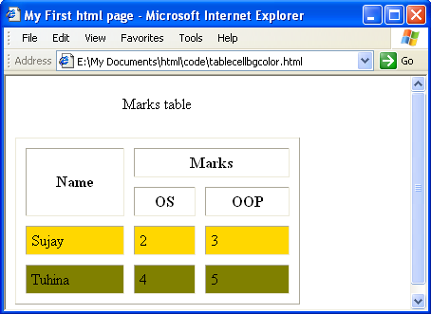
Creating Tables (contd.)
Background color of a row/cell
  bgcolor
…
  <tr bgcolor="gold"><td>Sujay</td><td>2</td><td>3</td></tr>
  <tr bgcolor="olive"><td>Tuhina</td><td>4</td><td>5</td></tr>
  …

Slide 46
Working with forms
Used to send user supplied data to server program (CGI/JSP/ASP) over the Internet
Form can contain interface elements such as text fields, buttons, checkboxes, radio buttons and selection lists that let users to enter text and make choices
Interfaces are defined by INPUT or SELECTION tag
Elements are defined within FORM tag
Data can be passed using submit button

Slide 47
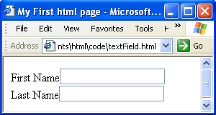
Text fields
INPUT tag, type is text
Used to specify single line textual data, such as name, email address, login name etc.
…
  <form>
  First Name<input type=“text”><br>
  Last Name<input type=“text”>
  </form>
  …

Slide 48
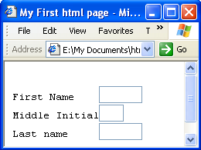
Text fields
Attributes
  size number of characters visible
  maxlength maximum number of characters that can be typed
…
  First Name <input type="text" size=5 maxlength=10>
  Middle Initial<input type="text" size=1>
  Last name <input type="text" size=5>
  …

Slide 49
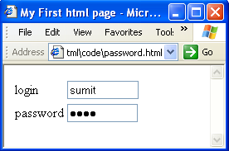
Password fields
INPUT tag, type is password
…
  <form>
  <table>
  <tr><td>login</td>
  <td><input type="text" size=10></td></tr>
  <tr><td>password</td>
  <td><input type="password" size=10></td></tr>
  </table>
  </form>
  …

Slide 50
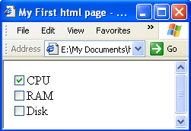
Check box
Used to specify true/false type options
…
  <form>
  <input type="checkbox" checked>CPU <br>
  <input type="checkbox">RAM <br>
  <input type="checkbox">Disk
  </form>
  …

Slide 51
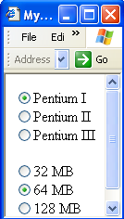
Radio buttons
Similar to checkbox, except that only one radio button in a group can be selected at a time
Group is specified by NAME attribute
…
  <input type="radio" name="CPU" checked>Pentium I<br>
  <input type="radio" name="CPU">Pentium II<br>
  <input type="radio" name="CPU">Pentium III<br>
  <p>
  <input type="radio" name="ram">32 MB<br>
  <input type="radio" name="ram" checked>64 MB<br>
  <input type="radio" name="ram">128 MB<br>
  …

Slide 52
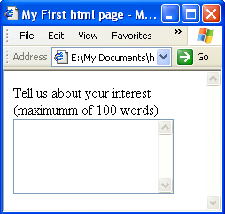
Text area
Allows users to enter lines of text
ROWS and COLS attributes fix the number of rows and column of the visible portion of text area
…
  <form>
  Tell us about your interest(maximumm of 100 words)
  <textarea cols=20 rows=5></textarea>
  </form>
  …

Slide 53
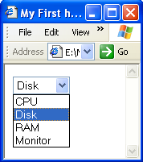
Selection list
Allows users to select an item from pull down menu
Options are included using OPTION tag
SIZE determines how many items are visible
MULTIPLE attribute allows the user to select multiple options at a time by holding down the shift key
  <form>
  <select>
  <option>CPU
  <option selected>Disk
  <option>RAM
  <option>Monitor
  </select>
  </form>

Slide 54
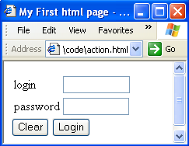
Action buttons
RESET button to clear contents of elements of a form
SUBMIT button to send the content of a form
  <form action="ckeck.jsp">
  …
  <input type="reset" value="Clear">
  <input type="submit" value="Login">
  </form>

